Slide 1

INTERNSHIP AT NANO RESEARCH CENTRE
Submitted in partial fulfillment of the
Requirements for the award of the degree
Of
BACHELORS OF ENGINEERING
In MECHATRONICS
Submitted to :- Submitted By: - Dr. H.S.GILL Name:- Kurella Alekhya
HOD Mechatronics UID: - 18BEM1020

Slide 2
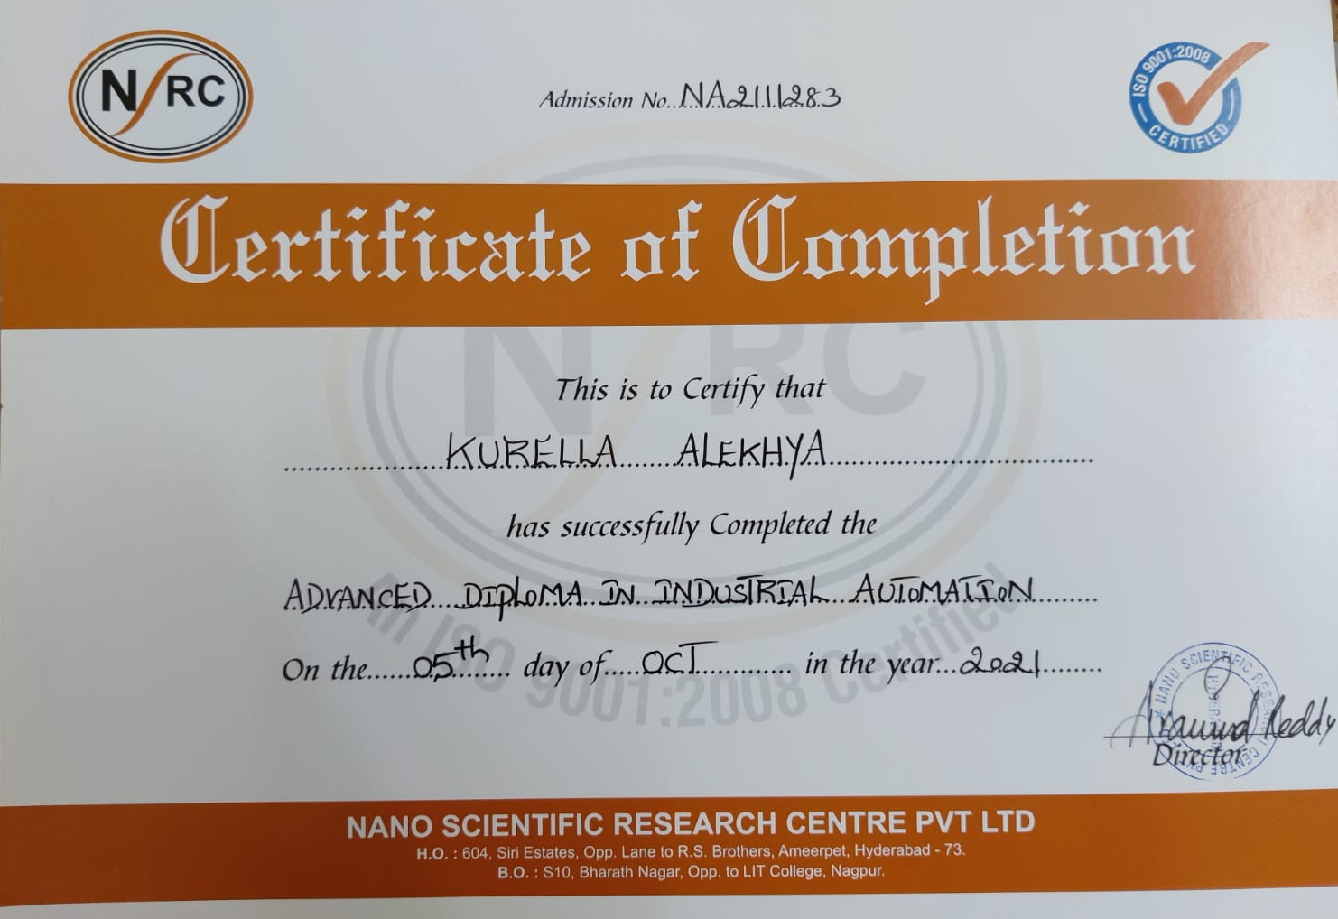
TRAINING CERTIFICATE

Slide 3
ABOUT THE TRAINING
PLCs (programmable logic controller) - It is a digitally operating system designed for using industrial environment.
SCADA (supervising control and data acquisition) – Allows industrial organizations to directly interact with devices like sensors, valves, etc.
VFD (variable frequency drive) – Type of motor controller that drives an electric motor by varying the frequency and voltage of its power supply.
HMI (human machine interface) – connects person to a device or system.

Slide 4
ACKNOWLEDGEMENT
I would like to acknowledge the NANO which gave the opportunity to learn and gain skills from their training and help me improve my technical skills and also nourish my knowledge .
I would like to extend my special thanks to Dr. H.S Gill (HOD Mechatronics) and Dr. Gurmeet Singh(Academic Co - ordinator) for guiding me to successfully complete this training within given time frame, and also making me aware about advantages of such trainings.

Slide 5
Company/ Academy PROFILE
Website Information :
NANO scientific research centre.
http://nanocdac.com/
INFO@NANOCDAC.COM

Slide 6
Academy Courses
There are very diverse Trainings offered by NANO like Ethical hacking ,Machine learning, Web development, Automation, Programming languages and Application software skills.

Slide 7
PROJECT WORK
&
SKILLS GAINED

Slide 8
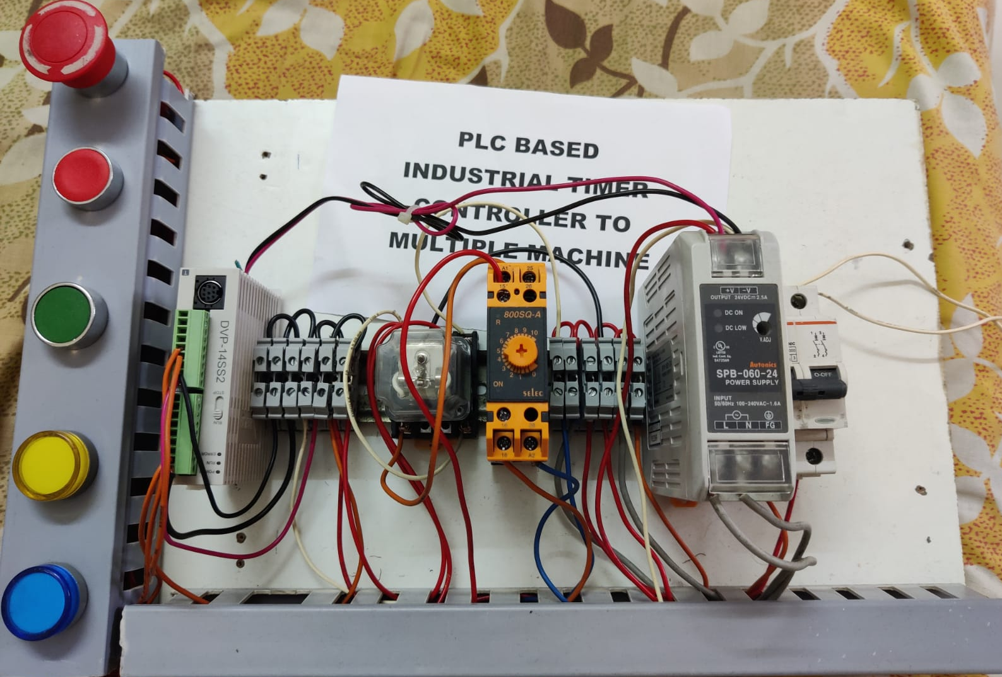
Project work done
The project is based on PLC based industrial timer controller to multiple machine.

Slide 9
Skills Gained
Learned basics about Industrial Automation
Learned about various PLCs , SCADA, VFDs, ETC.
Knowledge to programme the PLCs and working with the interface between computer and components
Prevention of trouble shooting and human injuries.
Able to do a project related to Industrial Automation.

Slide 10
CONCLUSION
I have learned Industrial Automation .Worked on some PLCs, SCADA, HMI and VFD which help me complete my project and gain knowledge regarding how the industrial automation works.
At the end I would like to conclude that this summer training provided a lot of knowledge and skills to me which I can implement in real world and will make me an important asset for any organization, and I would like to continue doing these trainings and learn more .

Slide 11
REFRENCES
http://nanocdac.com/
INFO@NANOCDAC.COM

Slide 12
THANK YOU !

